Slide 1


EcoEclipse
एक कदम पर्यावरण की ओर

Slide 2

Problem: Increasing environmental footprint due to lack of awareness and actionable steps among individuals.
Goal: To provide a platform that calculates environmental footprint, sets goals, shares public awareness posts, and organizes eco-friendly events.
Issues Addressed:
Lack of knowledge about personal environmental impact
Difficulty in finding reliable information on eco-friendly practices
Need for community engagement in environmental conservation

Slide 3
Key Stakeholders:
Environmentally conscious individuals
Environmental organizations
Educational institutions
Community leaders

Slide 4
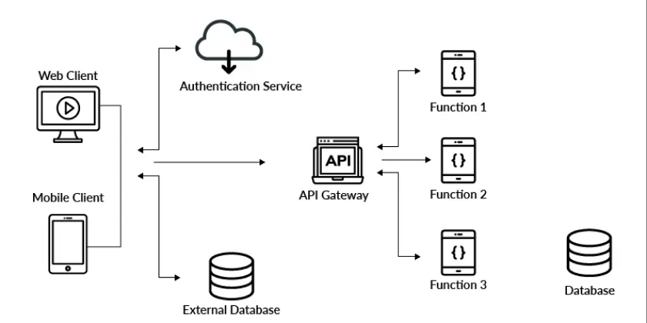
Architecture Diagram:

Slide 5
Functionality :
Footprint Calculator: Users can input their daily activities to calculate their environmental footprint.
Goal Setting: Users can set personal environmental goals and track their progress.
Public Awareness Posts: Users can create and share posts to raise awareness about environmental issues and solutions.
Themed Events: Admins can generate and manage events like Meatless Monday to promote eco-friendly practices.

Slide 6
Methodology:
Research: Conducted to understand the key factors influencing individual environmental footprints.
Design: Created user-friendly interfaces and user experience designs for easy navigation and interaction.
Development: Used MERN stack to develop the application, ensuring seamless integration of features.
Testing: Conducted user testing to identify and fix any issues, ensuring a smooth user experience.
Deployment: Deployed on a cloud platform for accessibility and scalability.

Slide 7

Output Format :
Web Application: Accessible through modern web browsers on both desktop and mobile devices.
Add QR & Link

Slide 8
Technology Stack:
Frontend: React.js
Backend: Node.js, Express.js
Database: MongoDB
Hosting: Render and Netlify

Slide 9


